Slide 1
IS 120
CSS Responsive Design

Slide 2
Announcements
HW 7 will be posted after class
Dev Tool Demos on March 9th
  Details and sign up sheet in Slack

Slide 3
Responsive Design
Zions Bank https://www.tcbwa.com/

Slide 4
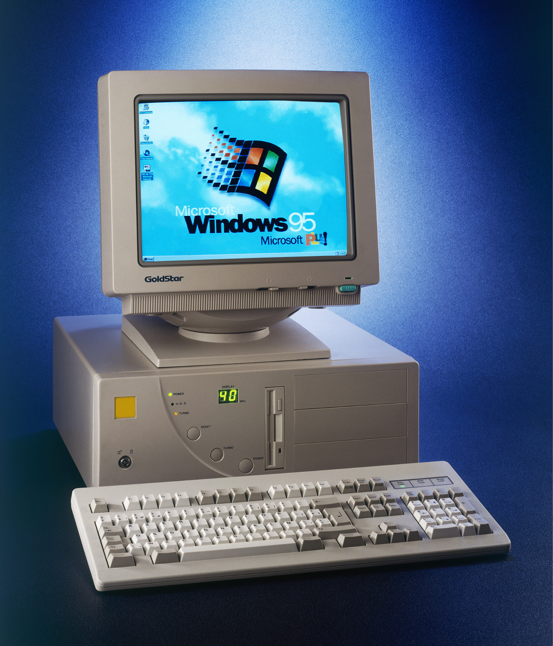
The Early Web
All screens were roughly the same size (~960px)
You would design a website once, and it would work the same for everyone

Slide 5
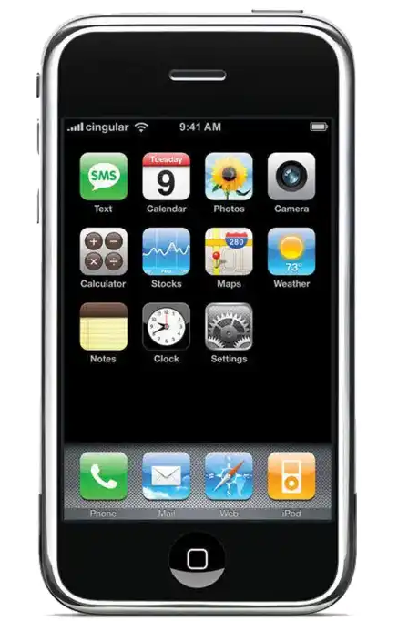
The Mobile Web
Websites now needed to be converted to a 320px screen
Adjustment was difficult for many companies, some just ignored it
Two separate codebases for desktop and mobile, a maintenance nightmare

Slide 6
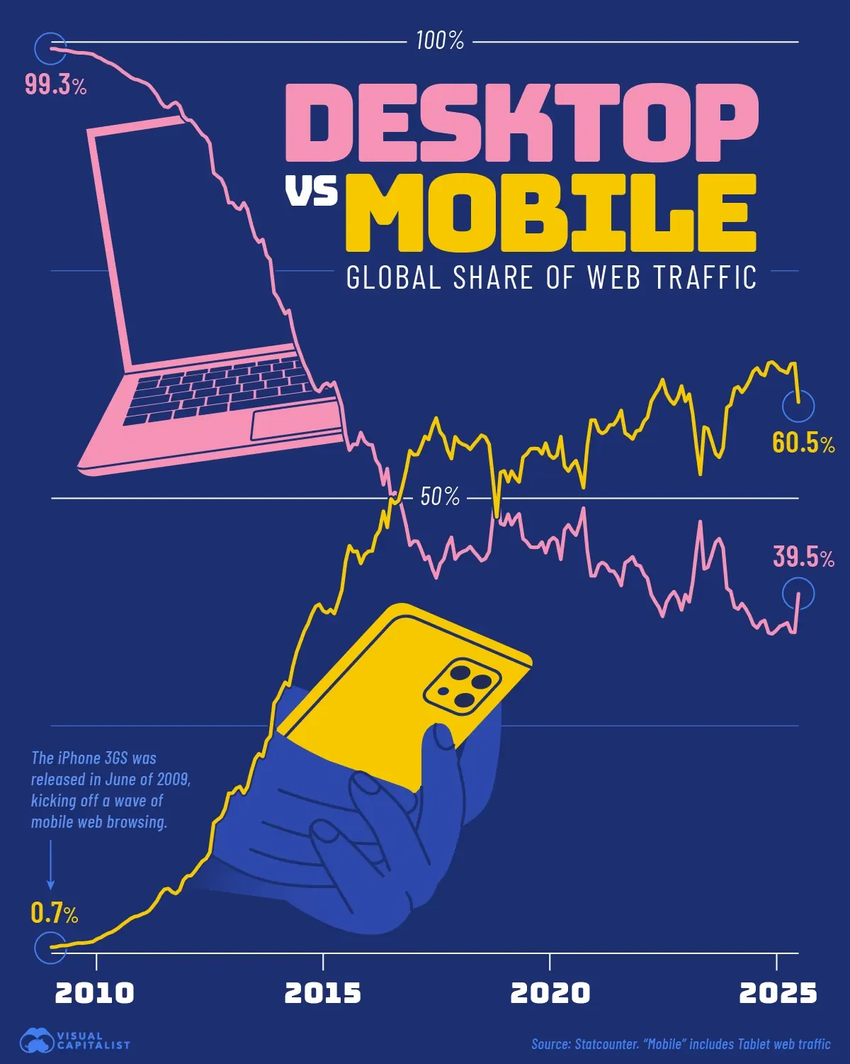
The Web Today
The majority of people access the web on their phone
Many websites’ first and only interactions happen on a phone

Slide 7
How Do You Build A Website for Both?
Mobile First
  Design a mobile website, modify it as screen sizes expand
Desktop First
  Design a desktop website, modify it as screen sizes shrink

Slide 8
Let’s Try Mobile First
Create a new HTML file and build a 3 card layout for mobile. Use Flexbox/Grid and responsive CSS units (%, vw/vh)
Change your web browser to a mobile view
  Inspect -> Toggle Device Toolbar -> Pick any mobile device
Don’t even think about desktop, just build it for mobile

Slide 9
Let’s Try Mobile First
After you’re done, try looking at your card layout on desktop
Share what you have with someone else
What works, what doesn’t?

Slide 10
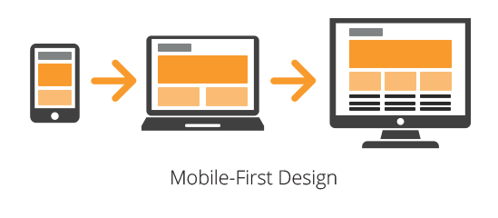
It’s easier to increase complexity rather than reduce it

Slide 11
Media Queries
Allows you to apply CSS only when certain conditions are met
  Most common is screen-width for responsive layouts
Often used as a “band-aid” for your CSS to make it responsive
Media queries are great, but use them intentionally

Slide 12
Media Query Breakpoints
A specific screen width where your layout needs to change
There’s lots of different breakpoint “standards”, just pick one and stick with it. (Bootstrap, Tailwind, or custom)
Less is more, the fewer breakpoints the better
Breakpoints are a great use for CSS variables!

Slide 13
Let’s go write some media queries

Slide 14
Fix Your Mobile First Cards
Find a partner, pair program to fix both of your card layouts
Use media queries if you need them, or see if you can find other ways to fix your layout!

Slide 15
Homework 7
Detailed instructions will be up after class
Take an existing page (HW6, Project 1) and make it responsive using media queries and breakpoints

